Slide 2
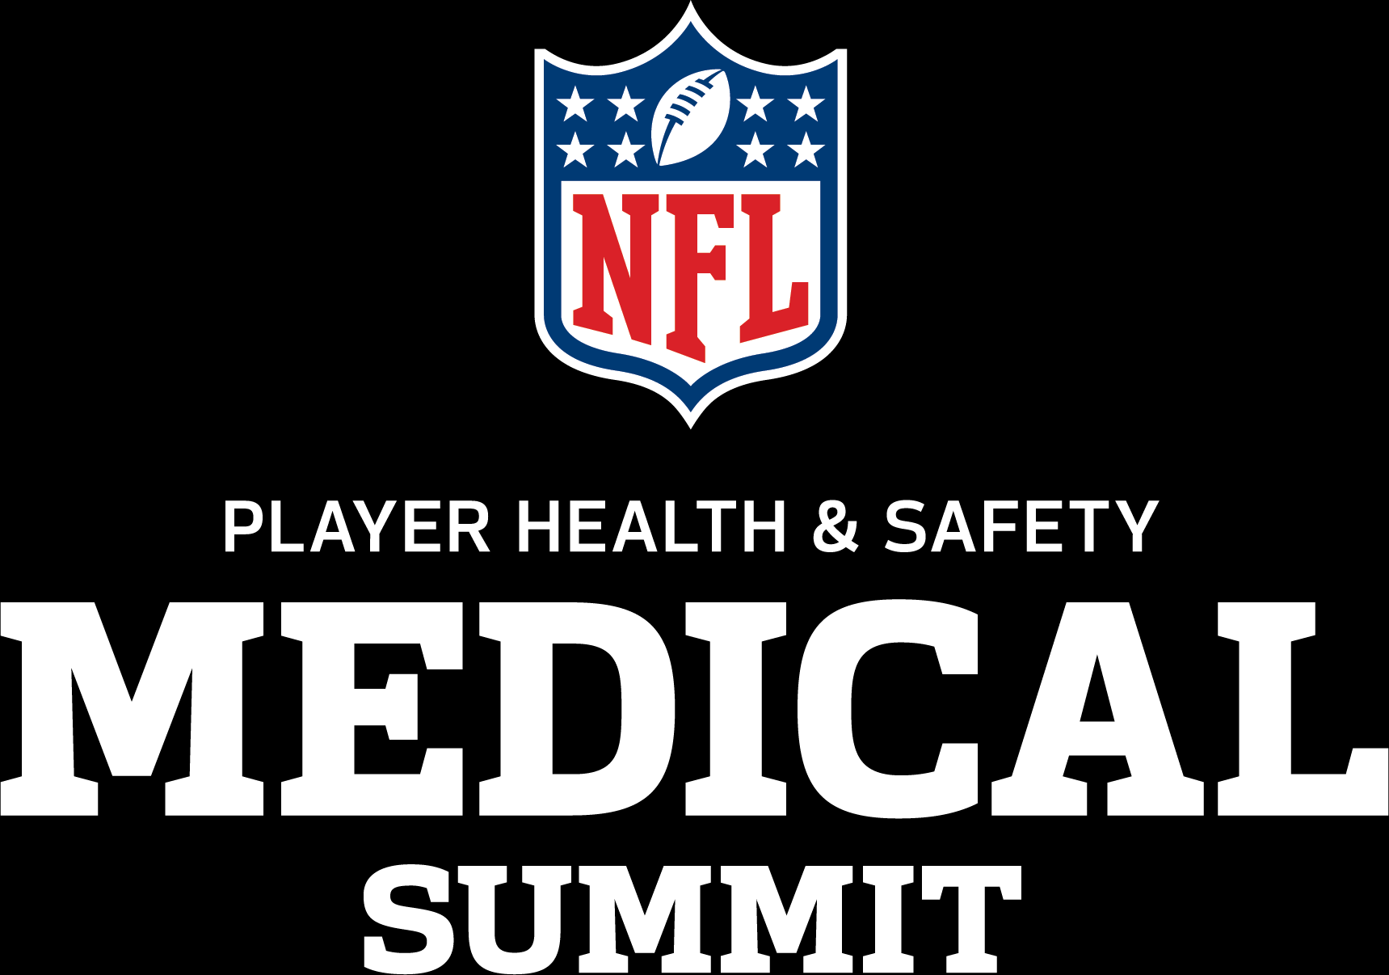
Player Health & Safety Communications Media Engagement Policies
Megan Grant
NFL Communications

Slide 3
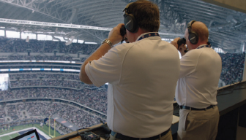
Game Day Media Policy
“Except as required as part of (INSERT GDA POSITION) services contemplated hereby, (INSERT GDA POSITION) are prohibited from speaking to any third parties (including but not limited to the media) in or about their role, activities or interactions as an (INSERT GDA POSITION).
“Any requests from third parties made to the (INSERT GDA POSITION) should be referred to the NFL public relations office.”

Slide 4
When in Doubt, Reach Out
Process
What’s the request?
HIPAA / privacy concerns
Coordination, as needed, with NFL, NFLPA, NFLPS, Clubs
Preparation
What’s the message you want to drive
On the record vs. on background
Practice
Study up on the reporter and outlet
Run through your talking points and tough q/a

Slide 5
Moving Forward
Major outlets
Local papers
University newsletters / papers
Op-eds
Hospital or institution profiles
Contact information:
Megan.Grant@NFL.com
401.578.3767

